Slide 1
Overview of Zambian PT Program
Management and Use of the PT Data Portal (electronic tool)
RTCQI – Zambia

Slide 2
Overview
Introduction
Overview of the Proficiency Testing (PT) Program
Organization of the PT program
PT Performance and Monitoring
Challenges / Best practices
Use and management of the data tool
Challenges
Way forward

Slide 3
Introduction
Quality Assurance (QA) programs assess the quality of testing and ensure accuracy and reliability of test results
Zambia established the National HIV External Quality Assurance Program (ZANQAP) in 2009
ZANQAP adopted Proficiency Testing (PT) and Site Supervisory Visits (SSVs) as the two (2) main EQA approaches
Launched RTCQI program in 2016 - Piloted in 4 of the 10 provinces
RTCQI scaled up to all 10 Provinces in 2018 – 2020

Slide 4
Transition
PT 001
2009
550
Testing Sites
Established the National HIV External Quality Assurance Program (ZANQAP) in 2009
1,196
Testing Sites
PT 009
2016
Launched the RTCQI Initiative – Piloted in four (4) of the total 10 provinces
PT 012
2018
1,504
Testing Sites
Scaled up the RTCQI initiative – All the ten (10) provinces of Zambia
PT 019
2023
3,667
Testing Sites
Increase sites participating in the HIV PT – Number of sites at most recent PT run – 2023

Slide 5
Overview of the Proficiency Testing (PT) Program
Description | Details
Type of Proficiency Testing | Hybrid PT Facility - Based PT Testers - Based PT | Facility Based PT – 3,667 Testing Sites Tester Based PT – 440 HIV RT Testers
Number of PT Cycles per Year | 2 PT Cycles per year | Currently at PT 019 Preparing for PT 020 – Phased scale up of tester-based PT
Period – Running PT Cycle | Cycle runs – Month Opens – 1st of the month Closes – Last day of the month | 1st Cycle – May 2nd Cycle – October
Tests in PT Program | HIV PT – PT 019 Recency HIV PT – RPT 006 | Merging of the HIV and Recency PT for PT 021 HIV PT – Recency PT 008
Administrating Body | National Reference Laboratory (NRL) - University teaching hospital | Located in an ISO 15189 accredited facility Enrolled in National QMS for ISO 17034

Slide 6
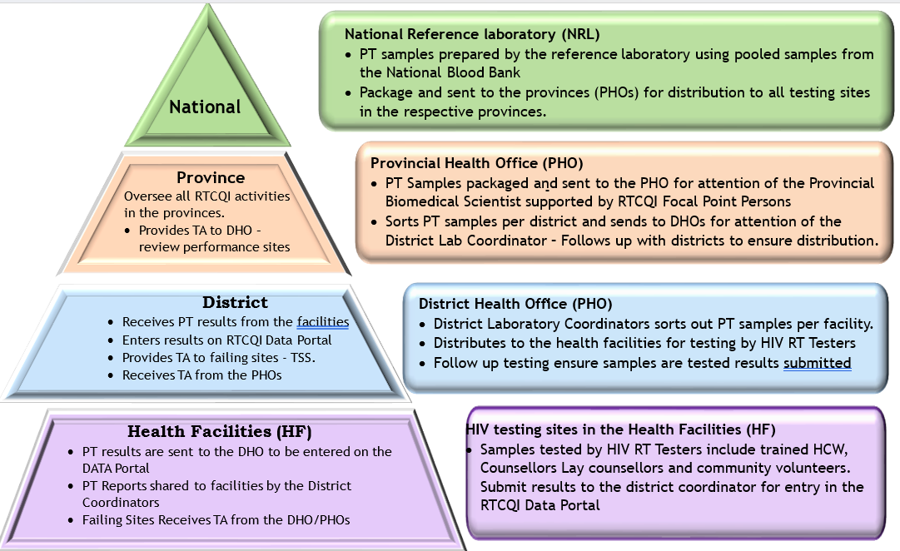
Organization of the PT program

Slide 7

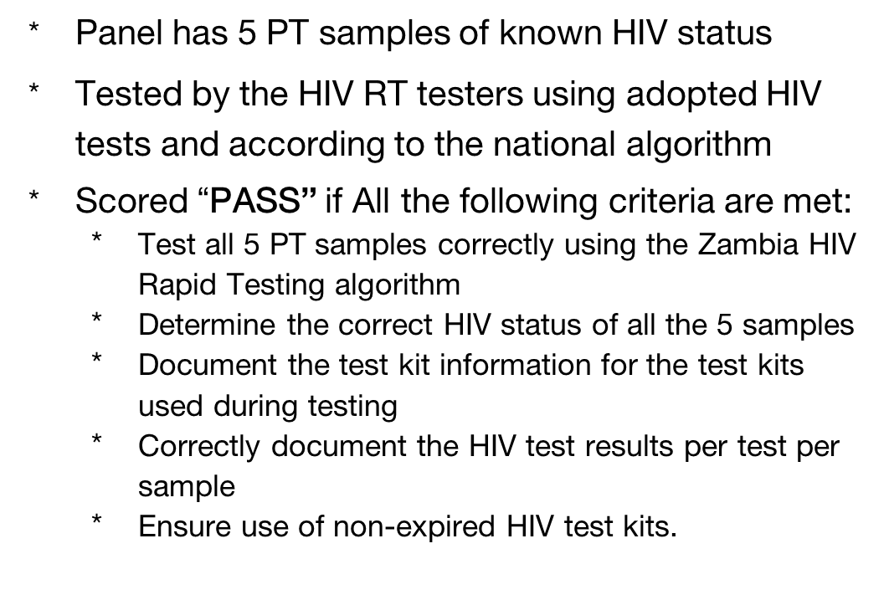
Pass Rate Target
National PT Pass Rate Target is 80%

Slide 8
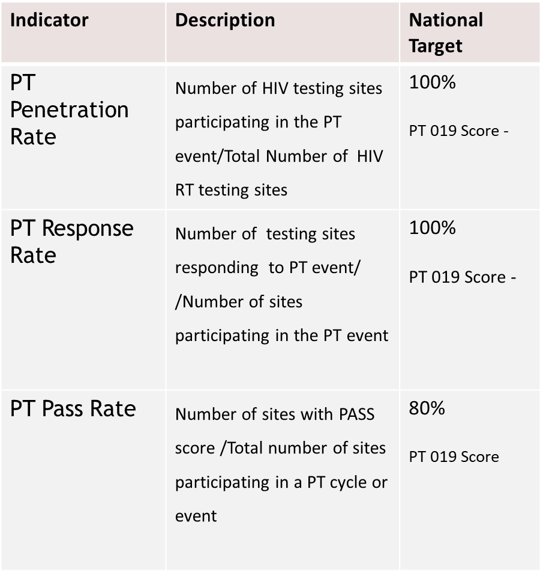
PT Performance Monitoring
77%
99.5%
8
75%

Slide 9
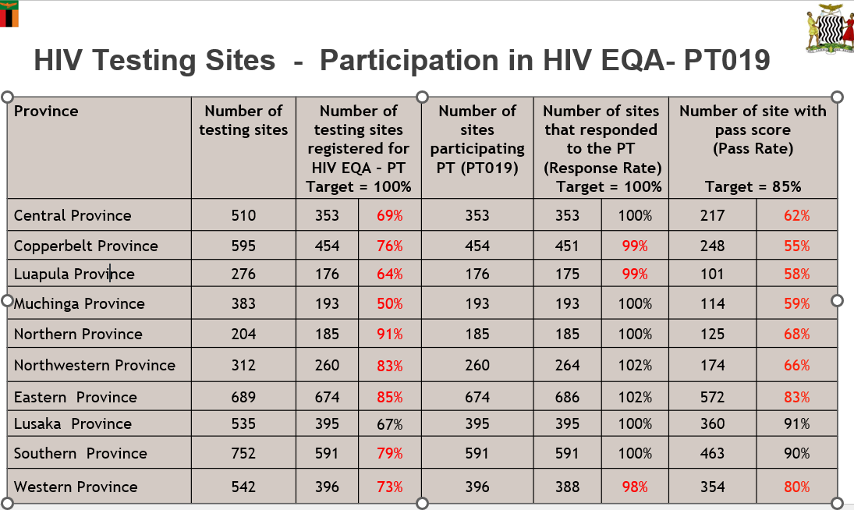
PT Performance Monitoring

Slide 10
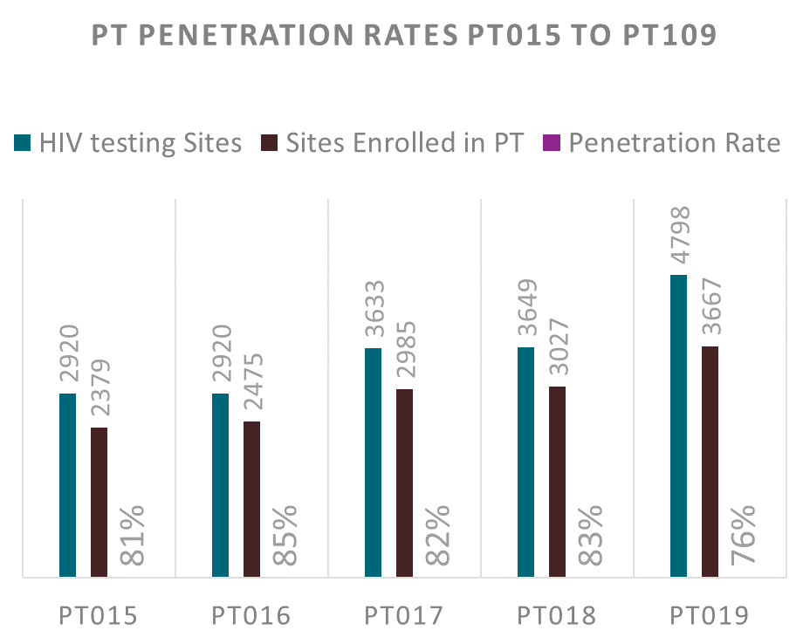

Slide 11
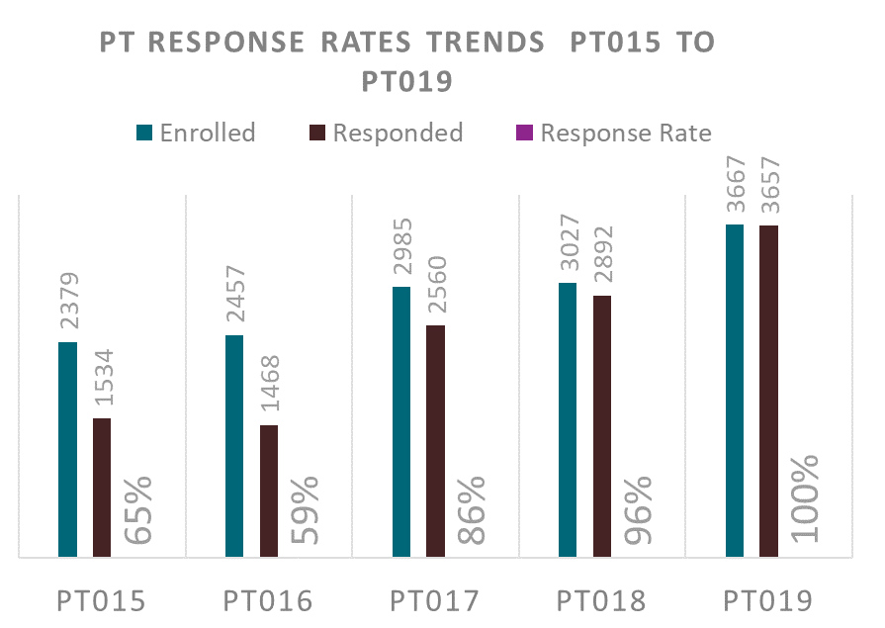

Slide 12
Best Practices
Best Practices - Improved PT Penetration Rate and PT Pass Rate
Engagement of PBS and RTCQI FPP prior to distribution of PT samples | Distribution of PT master list – Confirm sites in the province Indicate activity status of each sites Confirm sites participating in a given PT cycle Prepare for distribution of PT Samples on receipt
Engagement sessions during PT distribution Discuss challenges and propose way forward Facilitate processes – Engage Implementing partners and other stakeholders in the provinces | Virtual meeting with the PBS and all RTCQI FPP Review PT response rates Attend to challenges Provincial Engagements Creation of RTCQI National WhatsApp group – regular updates on response rates per province Advocate / Initiate in Province Review Meeting to monitor Response Rates
Post PT Results Dissemination | Disseminate results of the performance of the provinces Impress provinces to distribute results to district – initiate Post PT - TSS
RTCQI TWG Meeting | Review activities conducted by the provinces to Establish causes of poor performance Address the poor performance Track improvement efforts post interventions

Slide 13
Challenges
Not all testing sites are participating in the National HIV EQA-PT Scheme – national testing sites verification
Staff turnover affecting – participation in the tester based PT
Low pass rate among participating sites – verification exercise
Low participation in PT among private facilities
TSS in non partner supported sites

Slide 14
Use and management of RTCQI Data Portal (e-tool)

Slide 15
PT Electronic System – Data Portal
ZANQAS RTCQI Data Portal is a software program where results of tested HIV PT samples are submitted online and statistical analyzed
  Developed in 2018 and piloted in PT 012 in159 Sites
  Portal was further modified and upgraded in 2021 – Captures PT Data for all the testing site enrolled program – 3,667 testing Sites
  Currently undergoing improvements - making it more responsive to program needs

Slide 16
PT Electronic System – Data Portal
System Characteristics
  Web based - SSL Certificate
  Server hosted and managed in country – GRZ requirement
  Friendly interface - Easy to navigate
  Office 365 Business Standard Mail Boxes 10
  AZ/Virtual Machine – 2vCPU,4GB RAM, 256GB SSD 1 Standard F2sv
  Username and password required to access the portal
  Managed by RTCQI Data Manager

Slide 17
RTCQI Data Portal Information
Focus | Information available
Proficiency Testing – PT | Sites and Tester registered for PT as per most recent PT Cycle
 | Results of previous PT Cycles ( PT 010 – PT019)
HIV RT Tester information | Number and location of HIV RT Testers
 | Designation of the HIV RT Tester
 | Type of training offered to registered HIV testers
 | Certification status of tester – Validity of the tester certificated – Generate tester competency certificates
 | Validity of the HIV RT tester certificate
Testing Site information | Number and location of the HIV testing site
 | HIV testing modalities per facility
 | Testings Status of site – Prior to PT Run
General Management | Who has access to the system
 | What has been done on the system – Digital footprint

Slide 18
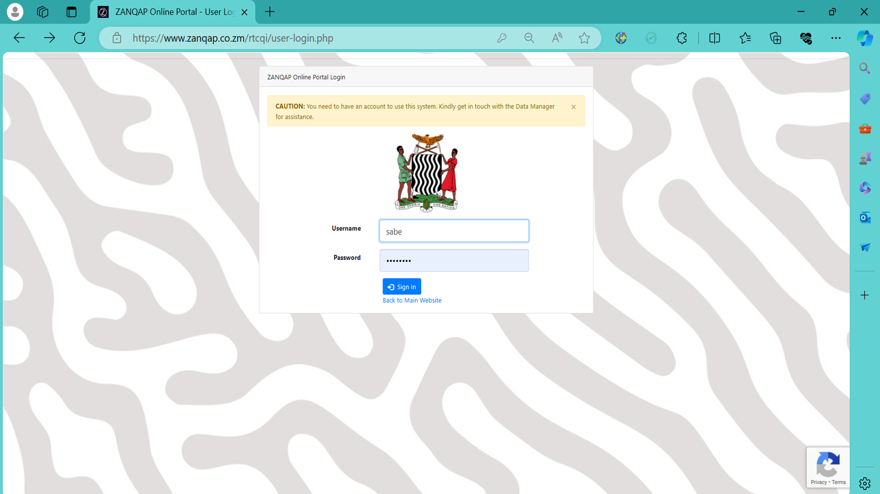

Slide 19
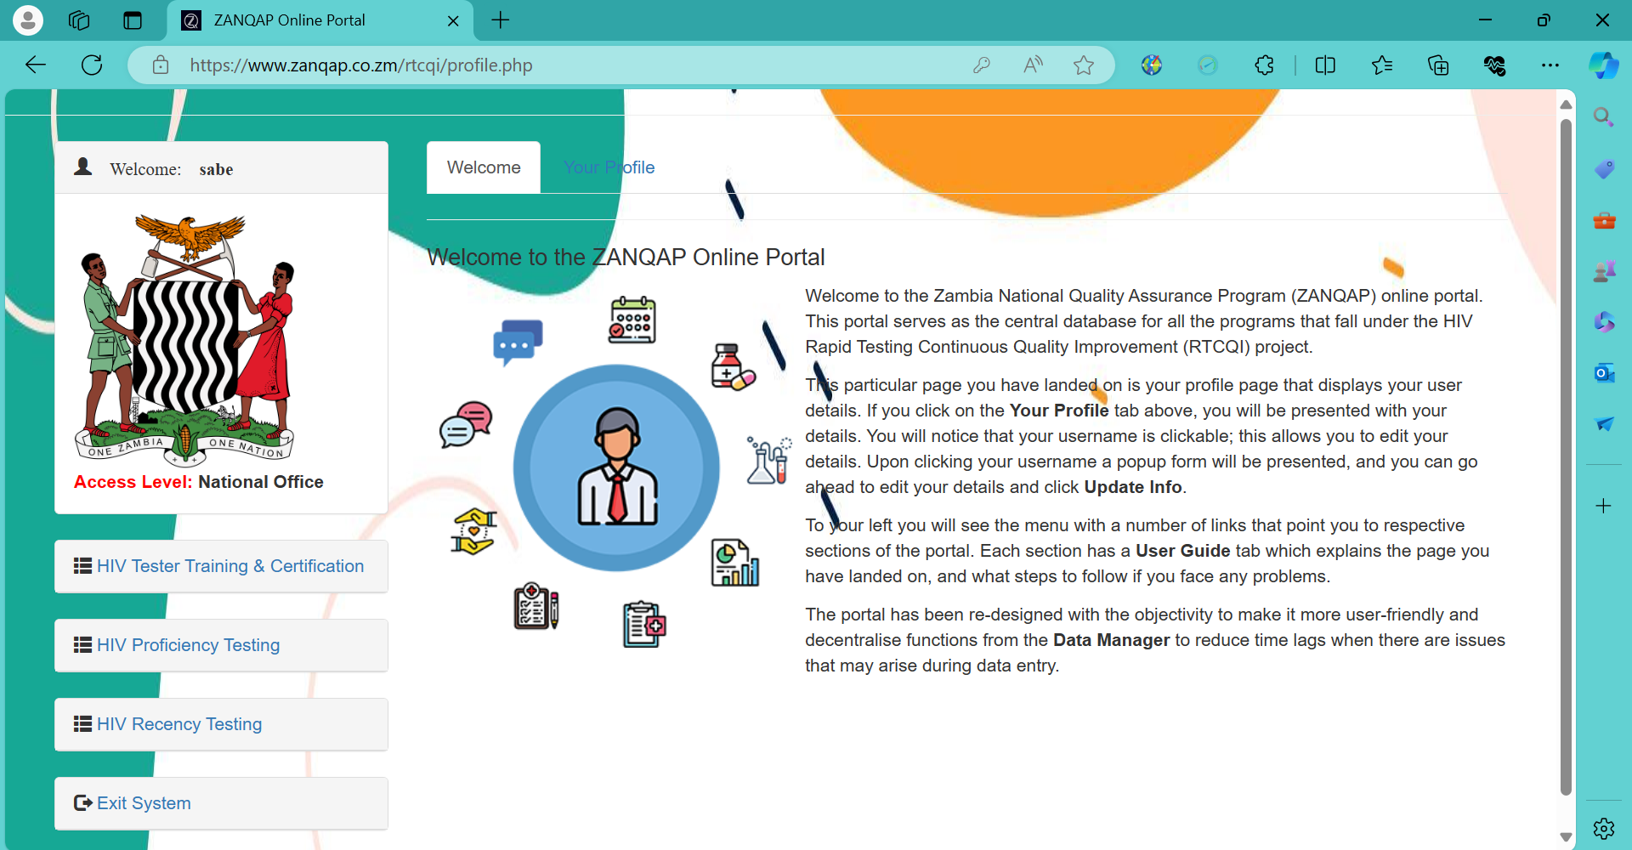

Slide 20
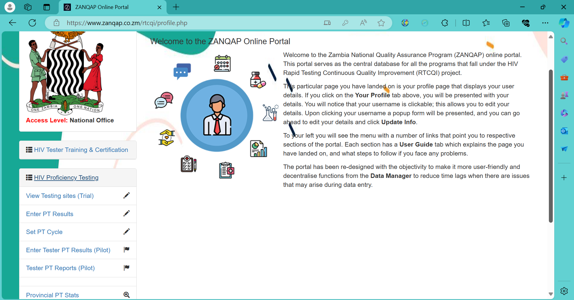
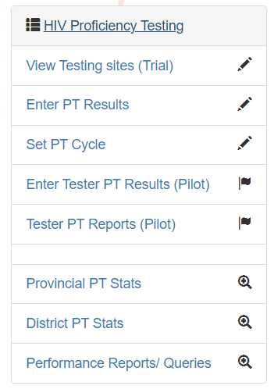

Slide 22
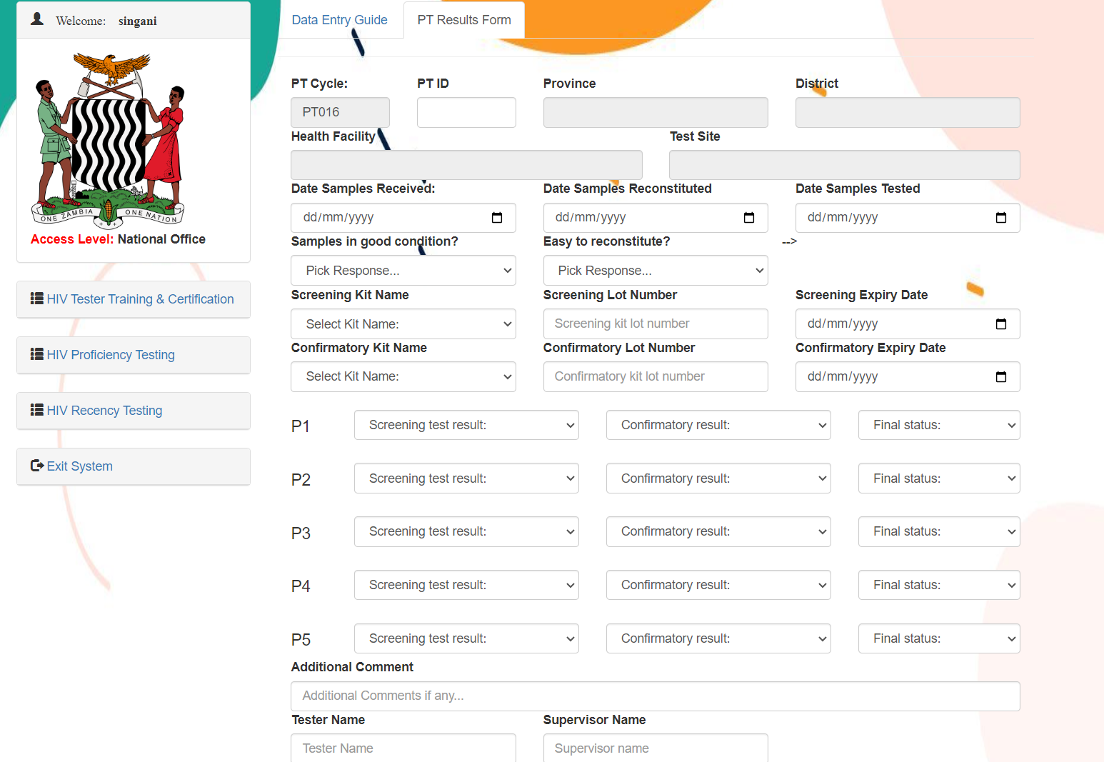

Slide 23
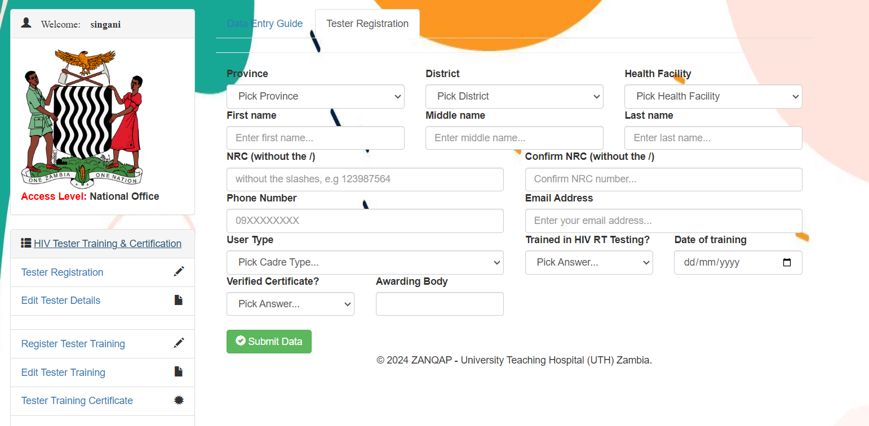
HIV Tester Module – RTCQI Data Portal

Slide 24
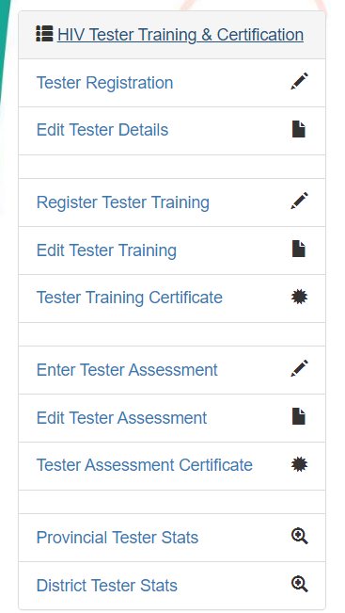

HIV Tester Module – RTCQI Data Portal

Slide 25
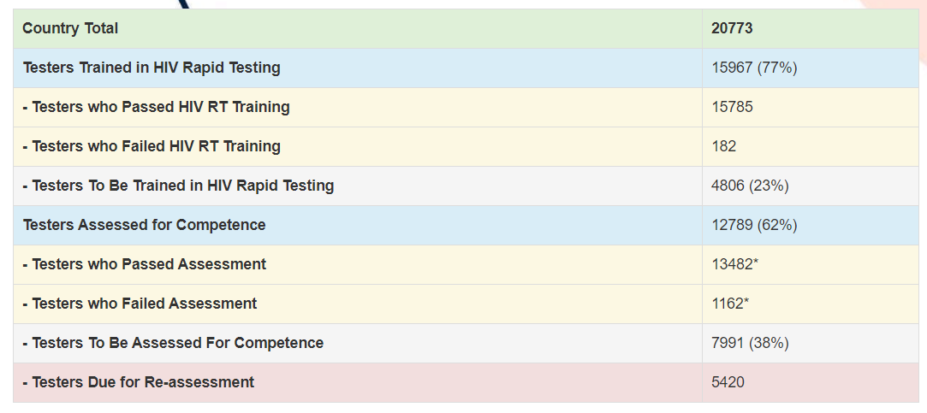
Summary Statistics

Slide 26
System Cost
Description | Amount ($)
Hardware Related Costs | 5,000 (once off cost )
Virtual Server (Azure)- 2VCPU, 4GB RAM | 2,250
Dedicated Web hosting | 1,020 per year
SSL Certificate | 250 per year
Domain Registration | 50 per year
Domain Hosting | 150 per year
EaaS –Business Standard | 2,800 per year
Data Management Staff Costs | 1,500 per month
Total | $ 13,020

Slide 27
System Access and Control
 | Level of access | Activity
Provincial Biomedical Scientist (PBS) | Provincial | Registration of testing sites / HIV RT Testers Edit testing sites / HIV RT Testers details Indicate activity status of sites prior to PT run Entry of PT results Download PT results for sharing with participating sites/testers Monitor response rates of province during PT run Initiate requests for creation of account for users in the province
RTCQI Focal Point Person | Provincial | Registration of testing sites / HIV RT Testers Edit testing sites / HIV RT Testers details Indicate activity status of sites prior to PT run Entry of PT results Download PT results for sharing with participating sites/testers Monitor response rates of province during PT run Initiate requests for creation of account for users in the province
District Laboratory Coordinators | District | Registration of testing sites / HIV RT Testers Edit testing sites / HIV RT Testers details Indicate activity status of sites prior to PT run Entry of PT results/ Download PT results for sharing with participating sites/testers Monitor response rates of province during PT run Initiate requests for creation of account for users in the province

Slide 28
PT Portal Data Usage
National Level
  Track sites participation in the national HIV EQA PT scheme
  Track performance of sites participating in the national HIV EQA PT scheme
  Track testing activities – active/Inactive sites
  Inform decision on areas to focus on for improved performance – training testers
  Plan for PT consumables and related supplies
  Review impact of inputs to results obtained – sites performance – tester training
Provincial Level
  Target support efforts – Training/Mentorship
  Determine facilities that need trainings/TSS
District level & Facility
  Focus support on failing sites
  Develop mechanism to improve participation in given PT cycles
  Implement improvement activities
  Motivate of testing staff

Slide 29
Challenges
Recommendations
Network challenges – makes portal inaccessible
Engage more reliable service provider
Web host - not adapted to our type of clientele
Change in implementing partners - staff attrition – constantly update system users
Conduct regular HIV RT tester verification exercises
Change in implementing partners /staff attrition – constantly update HIV RT testers
Register more consistent staff – Frequent orientations on system use

Slide 30
Way forward
Various improvements to the system – including:
  Ensure individual HIV RT tester accounts in preparation for tester-based PT
  Access to facility mangers to download PT reports
  Review information of areas where testers perform poorly during the assessment with directly observed checklist
  Support HIV RT tester failing certification and needing recertification

Slide 31
Acknowledgements
PLSU – MoH
CDC
USAID
DOD
Implementing Partners
  CIDRZ
  CHAZ
  CHAI
  Action HIV
  PHOs - CoAg
  ZIH
  RTCZ
  ZAM-Health
  Check Up I & II

